Slide 1

Disease-Gene Prediction: A Machine Learning Perspective
by
Mounika D
Roll No. 214G1A3256
Likitha B
Roll No. 214G1A3246
Jayanth Babu G
Roll No. 214G1A3233
Navya Teja G
Roll No. 214G1A3263
Under the guidance of
Mrs. V. Kamakshamma, _{M. Tech., (Ph.D.)}
Assistant Professor
Department of Computer Science and Engineering (Data Science)
Srinivasa Ramanujan Institute of Technology
(Affiliated to JNTUA & Approved by AICTE) (Accredited by NAAC with ‘A’ Grade & Accredited by NBA (EEE, ECE & CSE)
Rotarypuram Village, B K Samudram Mandal, Ananthapuramu – 515701.
2024 - 2025

Slide 2

Contents
Abstract
Introduction
Literature survey
Proposed Work
References
GitHub Link
Queries

Slide 3
Abstract
Understanding the association between genes and genetic diseases is critical for advancing human health. This study addresses the challenge of identifying disease-associated genes through computational methods as an alternative to time-consuming and expensive experimental approaches. The primary objective is to develop and evaluate novel computational techniques incorporating advanced topological and biological features for gene-disease association. Using disease-gene data from DisGeNET, this project will assess methods based on metrics such as TP rate, FP rate, precision, recall, F-measure, and ROC curve. The aim is to demonstrate the potential of these methods to outperform existing state-of-the-art techniques. Notably, the Extreme Gradient Boosting Algorithm (XGBoost) is expected to show significant promise in studying major disease categories such as Group, Disease, and Phenotype, highlighting its potential for improving gene-disease association predictions.

Slide 4
Introduction
Project Description: This project predicts associations between genes and diseases using advanced machine learning algorithms. It addresses the growing need for efficient gene-disease link predictions in biomedical research. Algorithms like Random Forest, XGBoost, LightGBM, and KNN are utilized for disease classification. The system is deployed via Flask to provide real-time predictions, aiming to enhance genetic data analysis and promote personalized medicine.
Problem Statement: Traditional methods for identifying gene-disease associations are slow, error-prone, and unable to handle large datasets. The vast scale and complexity of genetic data demand automated, scalable solutions for accurate and efficient analysis. Machine learning offers a transformative approach to address these challenges.

Slide 5
Objective:
To create a cutting-edge computational framework that leverages advanced machine learning techniques and innovative preprocessing strategies to deliver highly accurate and reliable predictions of disease-gene associations, driving significant advancements in genetic research, personalized medicine, and disease diagnosis.

Slide 6
Introduction
Scope:
Create a scalable ML pipeline for genomic data processing.
Improve accuracy using advanced ML techniques.
Provide a web-based tool accessible to researchers and clinicians.
Ensure extensibility for future genetic datasets and bioinformatics projects.
Significance:
Revolutionizes gene-disease association analysis with cutting-edge ML algorithms.
Benefits genomics, bioinformatics, personalized medicine, and early diagnosis.
Saves time, improves accuracy, and accelerates research and healthcare advancements.

Slide 7
Literature Survey
No | Title | Author | Journal Name & Year | Methodology Adapted | Key Findings | Gaps
1. | Prediction and Validation of Gene-DiseaseAssociationsUsing Methods Inspired by Social Network Analyses | U. M. Singh-Blom, N. Natarajan, A. Tewari, J. O. Woods, I. S. Dhillon, E. M. Marcotte | The journal name is PLoS One,2013 | Social Network Approaches | Developed methods for predicting gene-disease associations based on social network analysis, validated with known associations. | Focuses on predicting gene-disease links but lacks integration with modern machine learning models, limiting accuracy.
2 | Identifying potential association on gene-disease network via dual hypergraph regularized least squares | H. Yang, Y. Ding, J. Tang, F. Guo | The journal name is BMC Genomics,2021 | Network-Based Methods | Proposed a dual hypergraph regularized least squares method for identifying gene-disease associations, enhancing prediction accuracy | Offers robust gene-disease network predictions but lacks flexibility in incorporating non-network-based genomic data.

Slide 8
Literature Survey
No | Title | Author | Journal Name & Year | Methodology Adapted | Key Findings | Gaps
3 | A deep learning framework for predicting disease-gene associations with functional modules and graph augmentation | X. Jia et al. | The journal name is BMC Bioinformatics, 2024 | Deep Learning methodology | Introduced a deep learning framework using functional modules and graph augmentation for improved gene-disease prediction. | Deep learning provides high accuracy but struggles with resource intensity and scalability when applied to large-scale genomic datasets

Slide 9
Proposed System
The proposed system leverages an integrated machine learning framework combining Random Forest, XGBoost, LightGBM, and K-Nearest Neighbors (KNN) to predict disease-gene associations with high accuracy and reliability. This multi-model approach ensures robustness by utilizing the unique strengths of each algorithm. Random Forest builds multiple decision trees using random subsets of data and features, aggregating their outputs to reduce overfitting and improve accuracy. XGBoost optimizes predictions by sequentially correcting errors through gradient boosting and pruning weak nodes to prevent overfitting. LightGBM further enhances performance with a leaf-wise tree growth strategy and histogram-based training for efficiency in large datasets. Meanwhile, KNN classifies data based on the closest neighbors, offering simplicity and effectiveness for local pattern recognition. These models work together to compare and consolidate predictions, ensuring comprehensive and reliable results.

Slide 10
Proposed System
Advanced preprocessing techniques, such as handling missing values, label encoding, and KMeans clustering, are applied to improve data quality and enhance model performance. The integration of these machine learning models allows the system to deliver precise predictions, achieving high accuracy in identifying disease-gene associations. The system is deployed as a user-friendly Flask application, enabling real-time usage for researchers and healthcare professionals. This robust solution significantly contributes to personalized medicine, genetic research, and disease diagnosis by offering a scalable and efficient computational method for bioinformatics analysis.

Slide 11
Reference
[1] U. M. Singh-Blom, N. Natarajan, A. Tewari, J. O. Woods, I. S. Dhillon, and E. M. Marcotte, “Prediction and Validation of Gene-Disease Associations Using Methods Inspired by Social Network Analyses,” PLoS One, vol. 8, no. 5, p. e58977, May 2013, doi: 10.1371/JOURNAL.PONE.0058977.
[2] X. Jia et al., “A deep learning framework for predicting disease-gene associations with functional modules and graph augmentation,” BMC Bioinformatics, vol. 25, no. 1, pp. 1–14, Dec. 2024, doi: 10.1186/S12859-024-05841-3/TABLES/2.
[3] H. Yang, Y. Ding, J. Tang, and F. Guo, “Identifying potential association on gene-disease network via dual hypergraph regularized least squares,” BMC Genomics, vol. 22, no. 1, pp. 1–16, Dec. 2021, doi: 10.1186/S12864-021-07864-Z/TABLES/9.

Slide 12
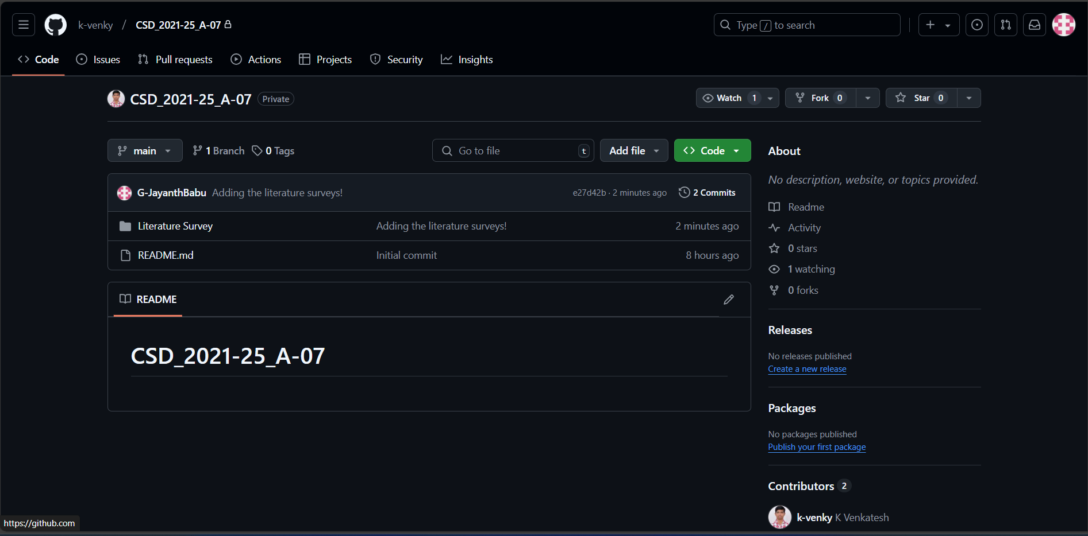

Git Hub Dashboards of each student

Slide 13
Any Queries?

Slide 14
Thank You!!!

